Slide 1
Proposal for Digital Systems
For TOUCH New York

Slide 2
Reasoning
If TOUCH is not already using digital systems, I believe switching over to digital would be very beneficial.
Handwritten records can be difficult to retrieve and read. They may have cursive handwriting, or be mislabelled.
Everyone who volunteers should be able to access and read records easily; this would reduce the barrier for entry for volunteers.
Digital systems can accomplish that.

Slide 3
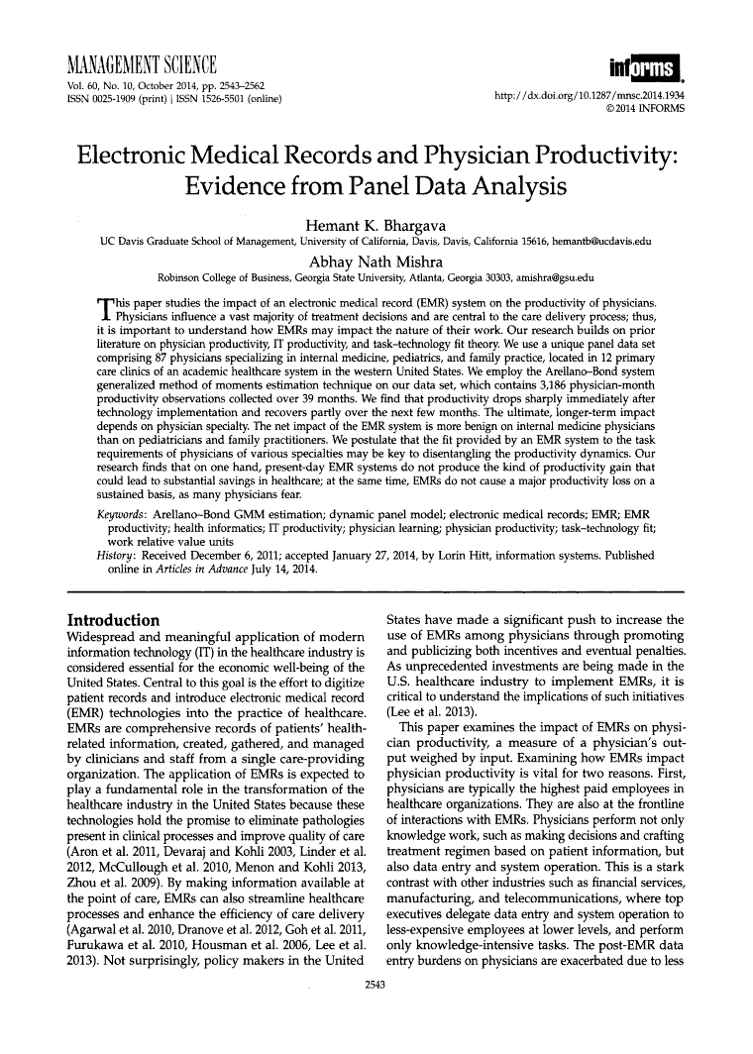
Evidence
This academic journal article from Management Science shows that switching to a digital system does not have a long-term negative impact on productivity.
Though the study shows that “productivity drops sharply immediately after technology implementation”, it recovers in a few months.
I’m sure any loss in productivity can be mitigated with ample training. The Interfaith Emergency Food Pantry of Pleasantville stated that their difficulties with their new digital system were caused by the fact that training started late.

Slide 4
Examples of Software Services that Provide Digital Recordkeeping to Food Pantries
Feeding Westchester provides digital sign-in and recordkeeping systems to food pantries, they may be able to provide their services to TOUCH.
BosWell is a free web-based service that aims to make it easy for food pantries to keep digital records, and connect clients of food pantries to healthcare providers (Many low-income people are covered by Medicaid, but do not know how to access healthcare)
There are other software services for food pantries that are not free, such as Pantry Saver and Food Pantry Helper.

Slide 5
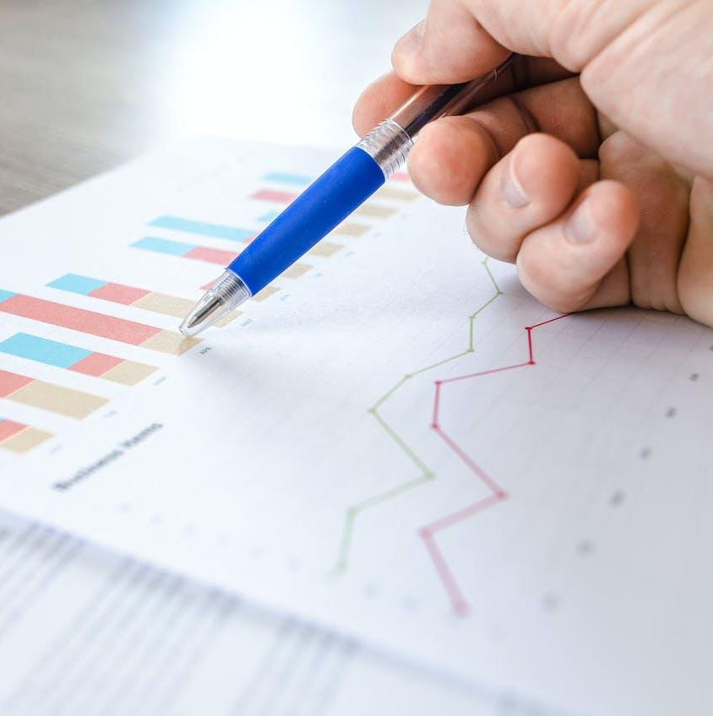
Other Ideas for Implementation:
Data Input
Some people may think that “digital system” means typing instead of handwriting. This thought can be frightening to those who feel uncomfortable with a keyboard.
Fortunately, there are other ways of inputting data that don’t involve using a keyboard, and should be much more intuitive.

Slide 6
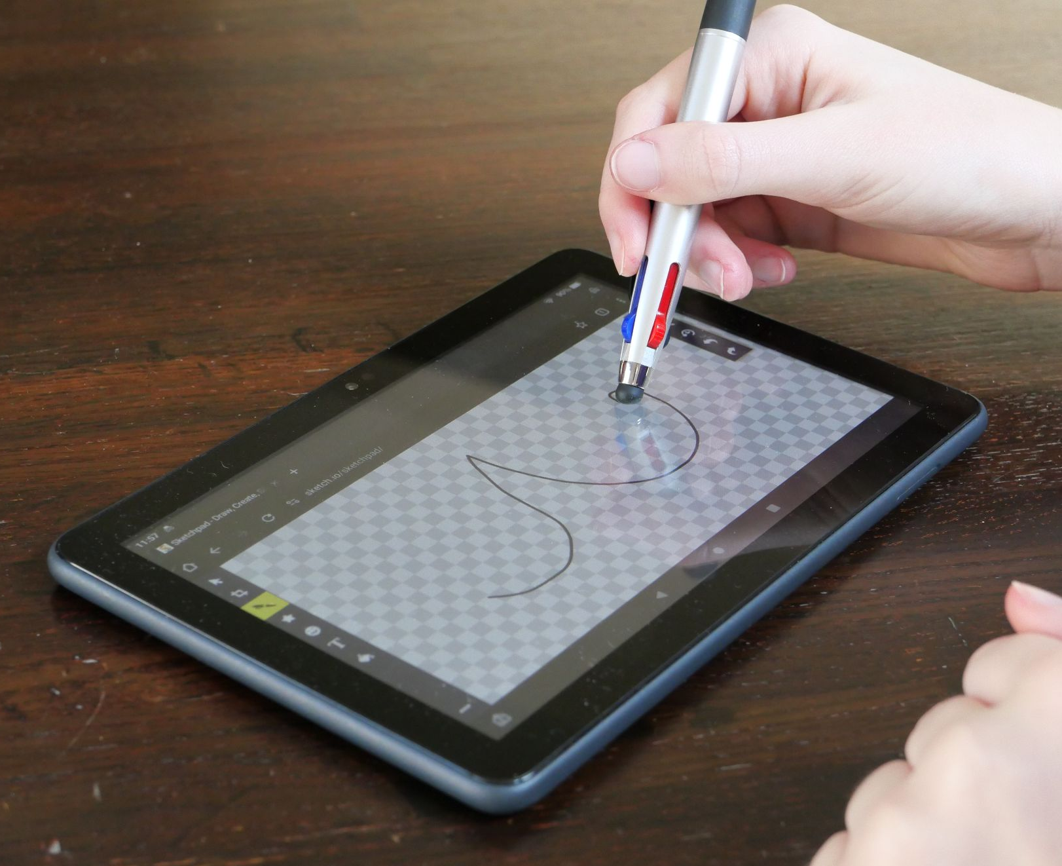
Data Input: Touch Screen and Pen
One can use a tablet with a touch screen compatible pen. A tablet can turn handwriting into plain text via OCR (optical character recognition). Passive pens are simple and inexpensive; a pack of ten touchscreen-pens costs only $6.
Notes:
TO DO: insert picture of a passive capacitive stylus and tablet here

Slide 7
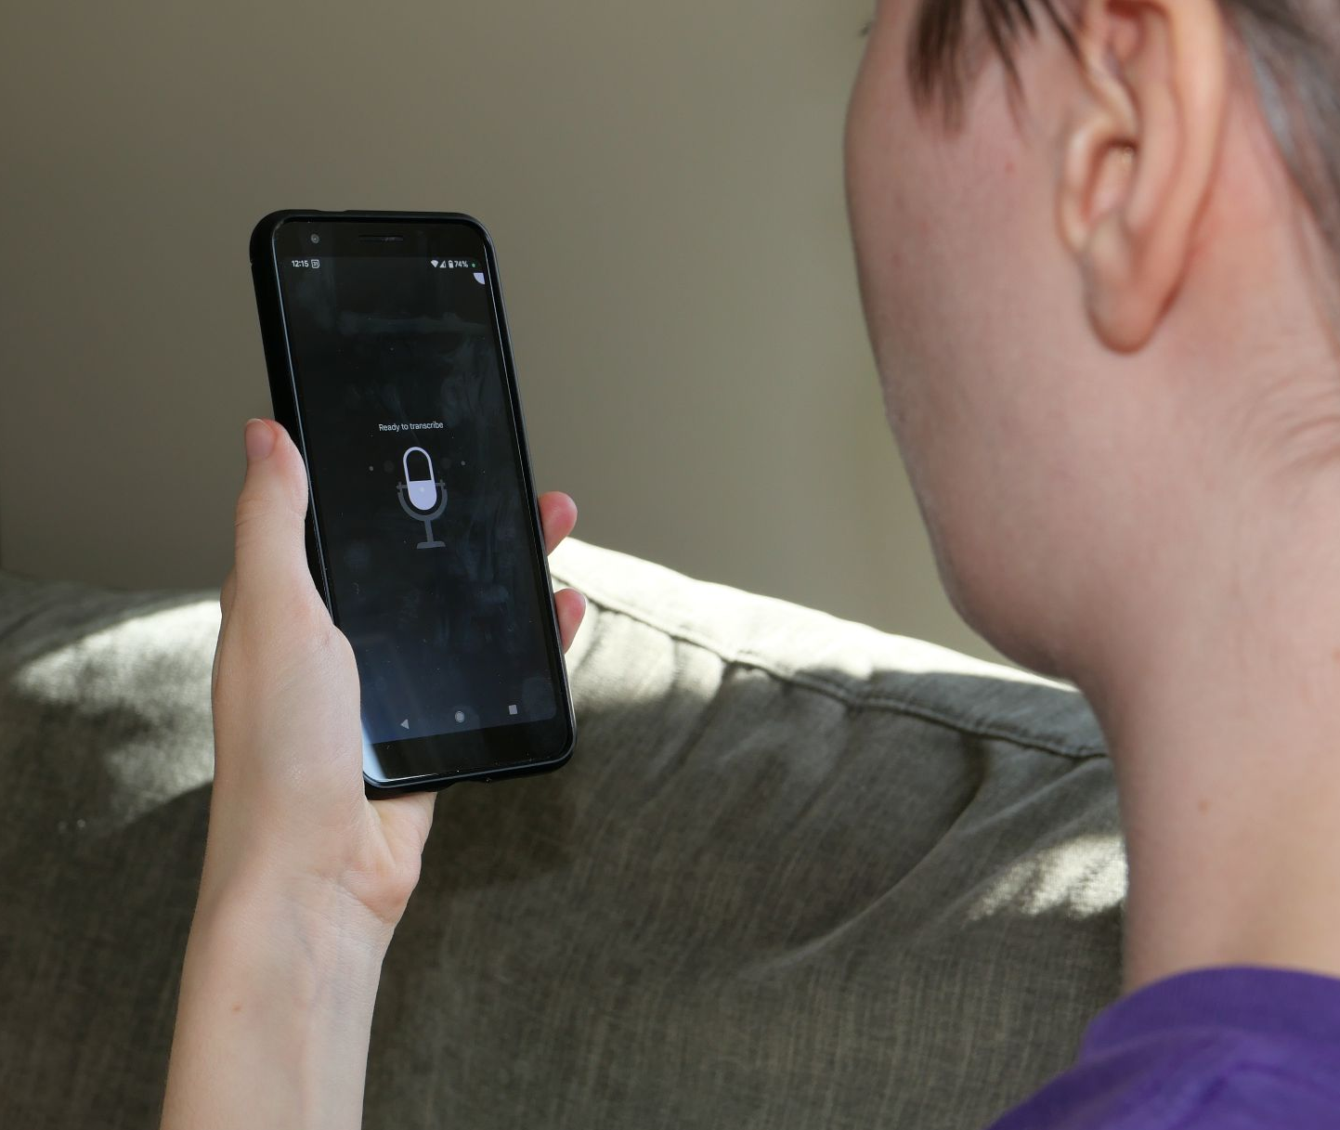
Data Input:
Speech-to-Text
Another option is speech-to-text. Any smartphone or tablet with a microphone likely already has access to this technology. With speech-to-text, you can simply speak into a microphone and have your words transcribed into text.

Slide 8
Thank you!

